Slide 1


<Gianluca Giulini>
<13/02/2025>

Slide 2

Outline
Executive Summary
Introduction
Methodology
Results
Conclusion
Appendix

Slide 3
Executive Summary
The methodologies adopted in this project are data collection (from public SpaceX API and by scrapping SpaceX Wikipedia page), data wrangling, exploratory data analysis (EDA) using visualization and SQL, interactive data analytics using Folium and Plotly Dash, and predicative analysis (with machine learning algorithms) using classification models.
The results include data analysis results, data visualization results, and predicative analysis results.

Slide 4
Introduction
Project background and context
The commercial space age is here and so many companies are working to make space travel affordable for everyone. Likely the most successful is SpaceX that advertises Falcon 9 rocket launches on its website with a cost of 62 million dollars whereas other providers cost more than 165 million dollars. Savings are mostly due to the fact that the first stage will be re-used after the launch Therefore, the goal of this project is to predict if the Falcon 9 first stage will land successfully, which can eventually determine the cost of a launch. Such information will be also useful for any company wishing to bid against SpaceX for a rocket launch investment.
Problems to be answered
What attributes and training labels need to be used for the predicative model.
The effect of each feature on the outcome of the launch.

Slide 5

Section 1

Slide 6
Methodology
Executive Summary
Data collection methodology:
Make a request to the SpaceX API
Web scraping from the Wikipedia page (https://en.wikipedia.org/wiki/List_of_Falcon_9_and_Falcon_Heavy_launches)
Perform data wrangling Convert landing outcomes to a binary format (like turning "successful" and "failed" into 1s and 0s) and create labels for outcomes
Perform exploratory data analysis (EDA) using visualization and SQL
Perform interactive visual analytics using Folium and Plotly Dash
Perform predictive analysis using classification models Initialize a set of classification models. Then, utilize Grid Search to determine the optimal hyperparameters for each model. Finally, compare the training and test accuracies of these models to identify the one with the highest performance.

Slide 7
Data Collection
Data collection process
For SpaceX API, we make a request to the SpaceX API and then go on to clean the requested data.
For web scraping, we extract a Falcon 9 launch records HTML table from Wikipedia and then parse the table and convert it into a Pandas data frame
SpaceX API Web scraping
Request various Launch data via SpaceX API
Get HTML response from the
Wikipedia page
Receive response and convert
it to a json file
Create a BeautifulSoup object from the HTML response
Normalize it and turn it into a Pandas data frame
and save it as a csv file
Normalize it and turn it into a Pandas data frame
and save it as a csv file

Slide 8
Data Collection – SpaceX API
Request rocket launch data to SpaceX API
Link to the SpaceX API calls on my notebook
https://github.com/bejaflor66/applied-data-science-capstone/blob/main/jupyter-labs-spacex-data-collection-api.ipynb
Decode the response content as a Json
Normalize it and turn it into a Pandas data frame
Get further information about the launches using the IDs given for each launch record.
From the rocket get the booster name and from the payload get the mass of the payload and the orbit
From the launchpad get the name of the launch site, the longitude and the latitude
From cores get the outcome of the landing, the type of the landing, number of flights and other landing parameters
Filter the data frame to only include Falcon 9 launches
Export data frame as CSV

Slide 9
Data Collection - Scraping
Link to the Web scraping notebook
https://github.com/bejaflor66/applied-data-science-capstone/blob/main/jupyter-labs-webscraping.ipynb
Request the Falcon9 Launch Wiki page from its URL
Create a BeautifulSoup object from the HTML response
Extract all column/variable names from the HTML table header
Create a data frame by parsing the launch HTML tables
Export data frame as CSV

Slide 10
Data Wrangling
Exploratory Data Analysis (EDA) to find some patterns in the data and determine what would be the label for training supervised models
Link to the Data Wrangling notebook
https://github.com/bejaflor66/applied-data-science-capstone/blob/main/labs-jupyter-spacex-Data%20wrangling.ipynb
Convert launch outcomes into Training Labels with 1 means the booster successfully landed and 0 means it was unsuccessful.
Identify and calculate the percentage of the missing values in each attribute
Identify which columns are numerical and categorical
Calculate the number of launches on each site
Calculate the number and occurrence of each orbit
Calculate the number and occurrence of mission outcome of the orbits
Create labels for outcomes
Export data frame as CSV

Slide 11
EDA with Data Visualization
Scatter plots to check how much the success of a landing is related to the following:
Flight Number vs. Payload Mass
Flight Number vs. Launch Site
Flight Number vs. Orbit Type
Pay Load Mass vs. Orbit
Bar chart:
Success Rate of Each Orbit Type
Line chart:
Year vs. Success Rate
Reference to the EDA with data visualization notebook: https://github.com/bejaflor66/applied-data-science-capstone/blob/main/edadataviz.ipynb

Slide 12
EDA with SQL
List of SQL query tasks performed for EDA
Display the names of the unique launch sites in the space mission
Display 5 records where launch sites begin with the string 'CCA’
Display the total payload mass carried by boosters launched by NASA (CRS)
Display average payload mass carried by booster version F9 v1.1
List the date when the first succesful landing outcome in ground pad was acheived.
List the names of the boosters which have success in drone ship and have payload mass greater than 4000 but less than
6000
List the total number of successful and failure mission outcomes
List the names of the booster_versions which have carried the maximum payload mass.
List the records which will display the month names, failure landing_outcomes in drone ship ,booster versions, launch_site for the months in year 2015.
Rank the count of landing outcomes (such as Failure (drone ship) or Success (ground pad)) between the date 2010-06-04
and 2017-03-20, in descending order.
https://github.com/bejaflor66/applied-data-science-capstone/blob/main/jupyter-labs-eda-sql-coursera_sqllite.ipynb
Reference to the EDA with SQL notebook:

Slide 13
Build an Interactive Map with Folium
United States Folium Map was created to show interactively the Launch sites
Circle markers were added to indicate the different launch sites. The color of the markers represent the launch outcomes, with green=success and red=failure
Lines were added to represent the distance between launch sites and its proximities.
Reference to the Interactive Map notebook: https://github.com/bejaflor66/applied-data-science-capstone/blob/main/lab_jupyter_launch_site_location.ipynb

Slide 14
Build a Dashboard with Plotly Dash
A Dashboard was developed to show:
A dropdown section which lists “All Sites” and individual launch sites to modify the results of the Pie chart
A Pie chart showing the total successful launches of all sites or a specific launch site
xA range slider which allows to select different Payload Mass ranges to filter the range of payload mass for the scatter plots.
Scatter plots showing the relationship between Outcome and Payload Mass for different Booster Versions.
Reference to the Dashboard Python project: https://github.com/bejaflor66/applied-data-science-capstone/blob/main/spacex_dash_app.py

Slide 15
Predictive Analysis (Classification)
Model Build-up
Load data
Load the dataset into a pandas dataframe
Data standardization and normalization
Split the data into training and testing data
Create a Logistic Regression, SVM, Decision Tree and KNN objects to initialize the ML model
Fit the objects to find the best parameters through GridSearch
Processing Split into training data and test data
Define and
initialize ML models
Model Evaluation
Check the accuracy on test data accuracy scores
See the confusion matrix
Find the best performing classification model
Choose the model with the highest accuracy scores
Grid Search to find the best parameters
Reference to the predictive analysis notebook:
https://github.com/bejaflor66/applied-data-science-capstone/blob/main/SpaceX_Machine%20Learning%20Prediction_Part_5.ipynb
Check model performance

Slide 16
Results
Exploratory data analysis results
Interactive analytics demo in screenshots
Predictive analysis results

Slide 17

Section 2

Slide 18
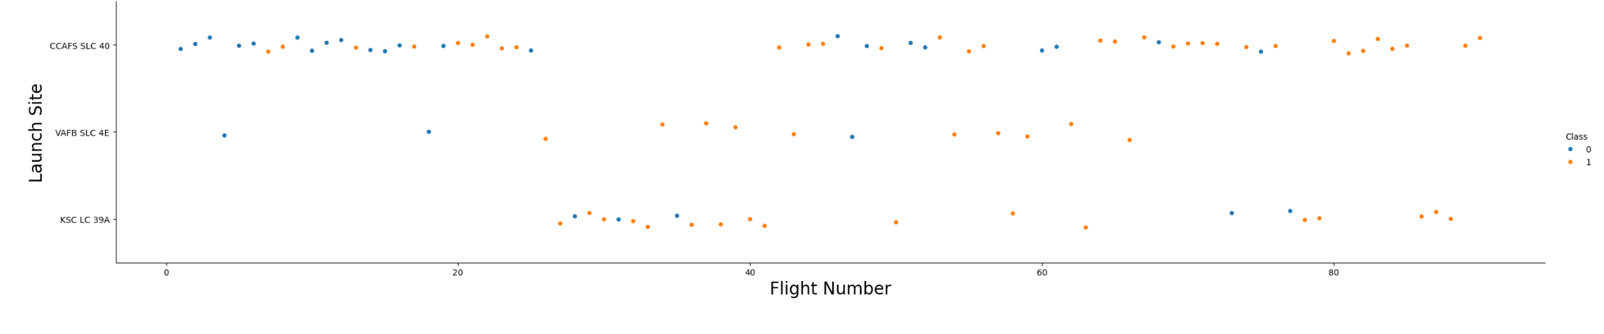
Flight Number vs. Launch Site
As shown in the chart, as the flight number increases, the launch outcome is likely to be successful.

Slide 19
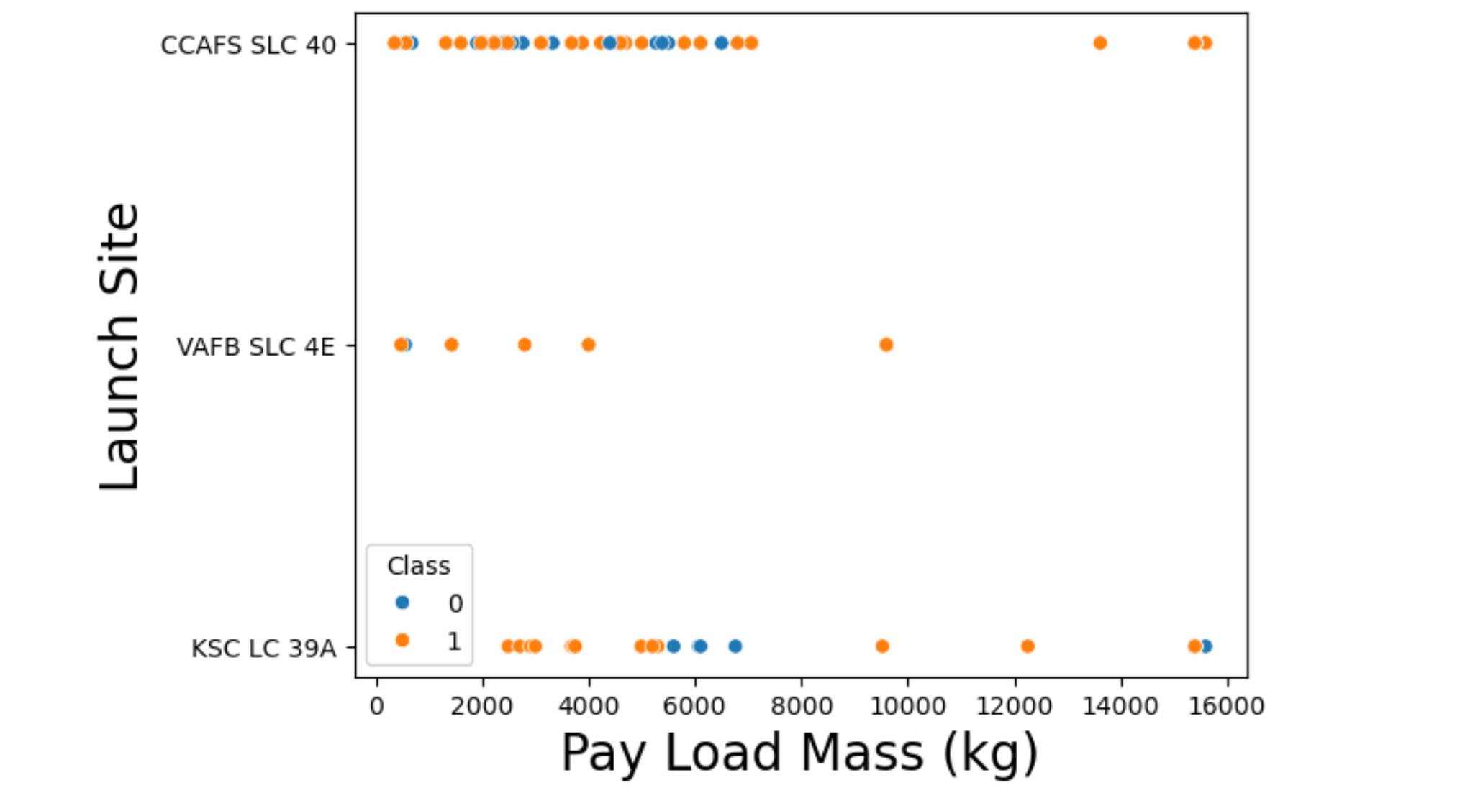
Payload vs. Launch Site
For CCAFS SLC-40, for small and medium payload mass the outcome does not seem to depend on it, but it is successful with big load mass;
For VAFB SLC-4E, as payload mass increases, the launch outcome tends to be successful;
For KSC LC-39A, with payload mass between 6000 and 8000 kg, the launch outcome failed.

Slide 20
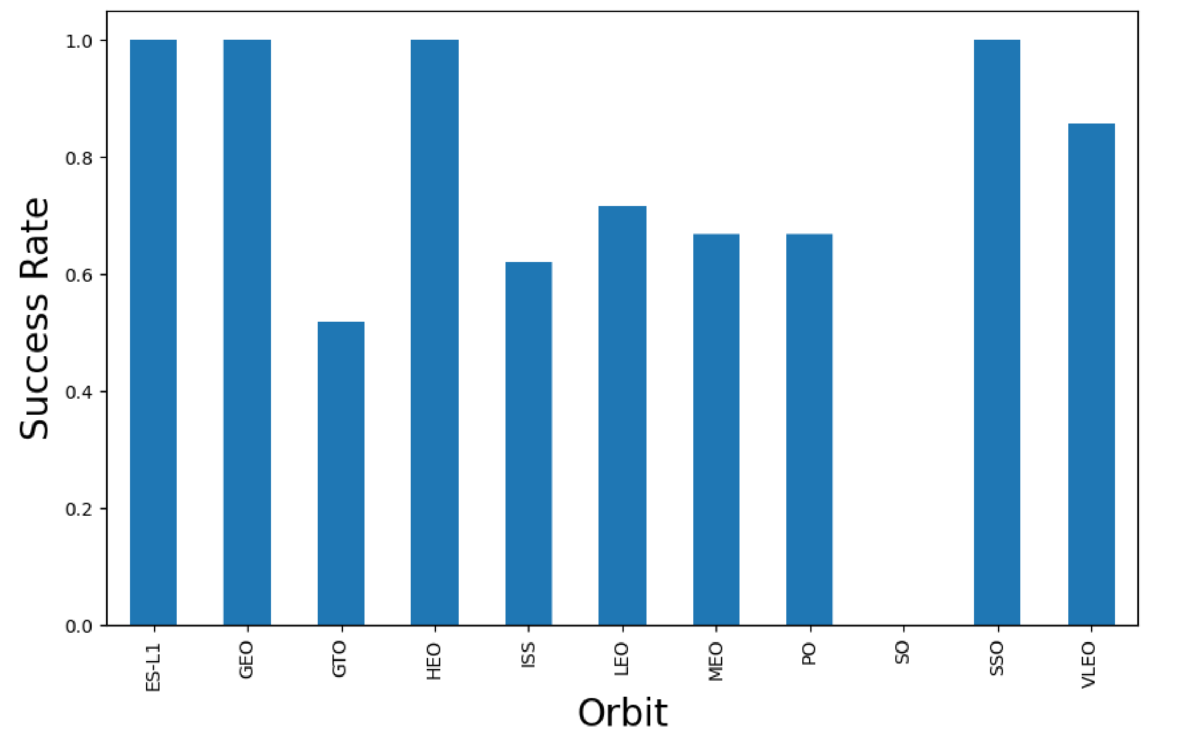
Success Rate vs. Orbit Type
ES-L1, GEO, HEO and SSO have the highest success rate. Vleo has 85% success rate while the others have between 45% and 70 % success rate. SO has no successful launch based on data available

Slide 21
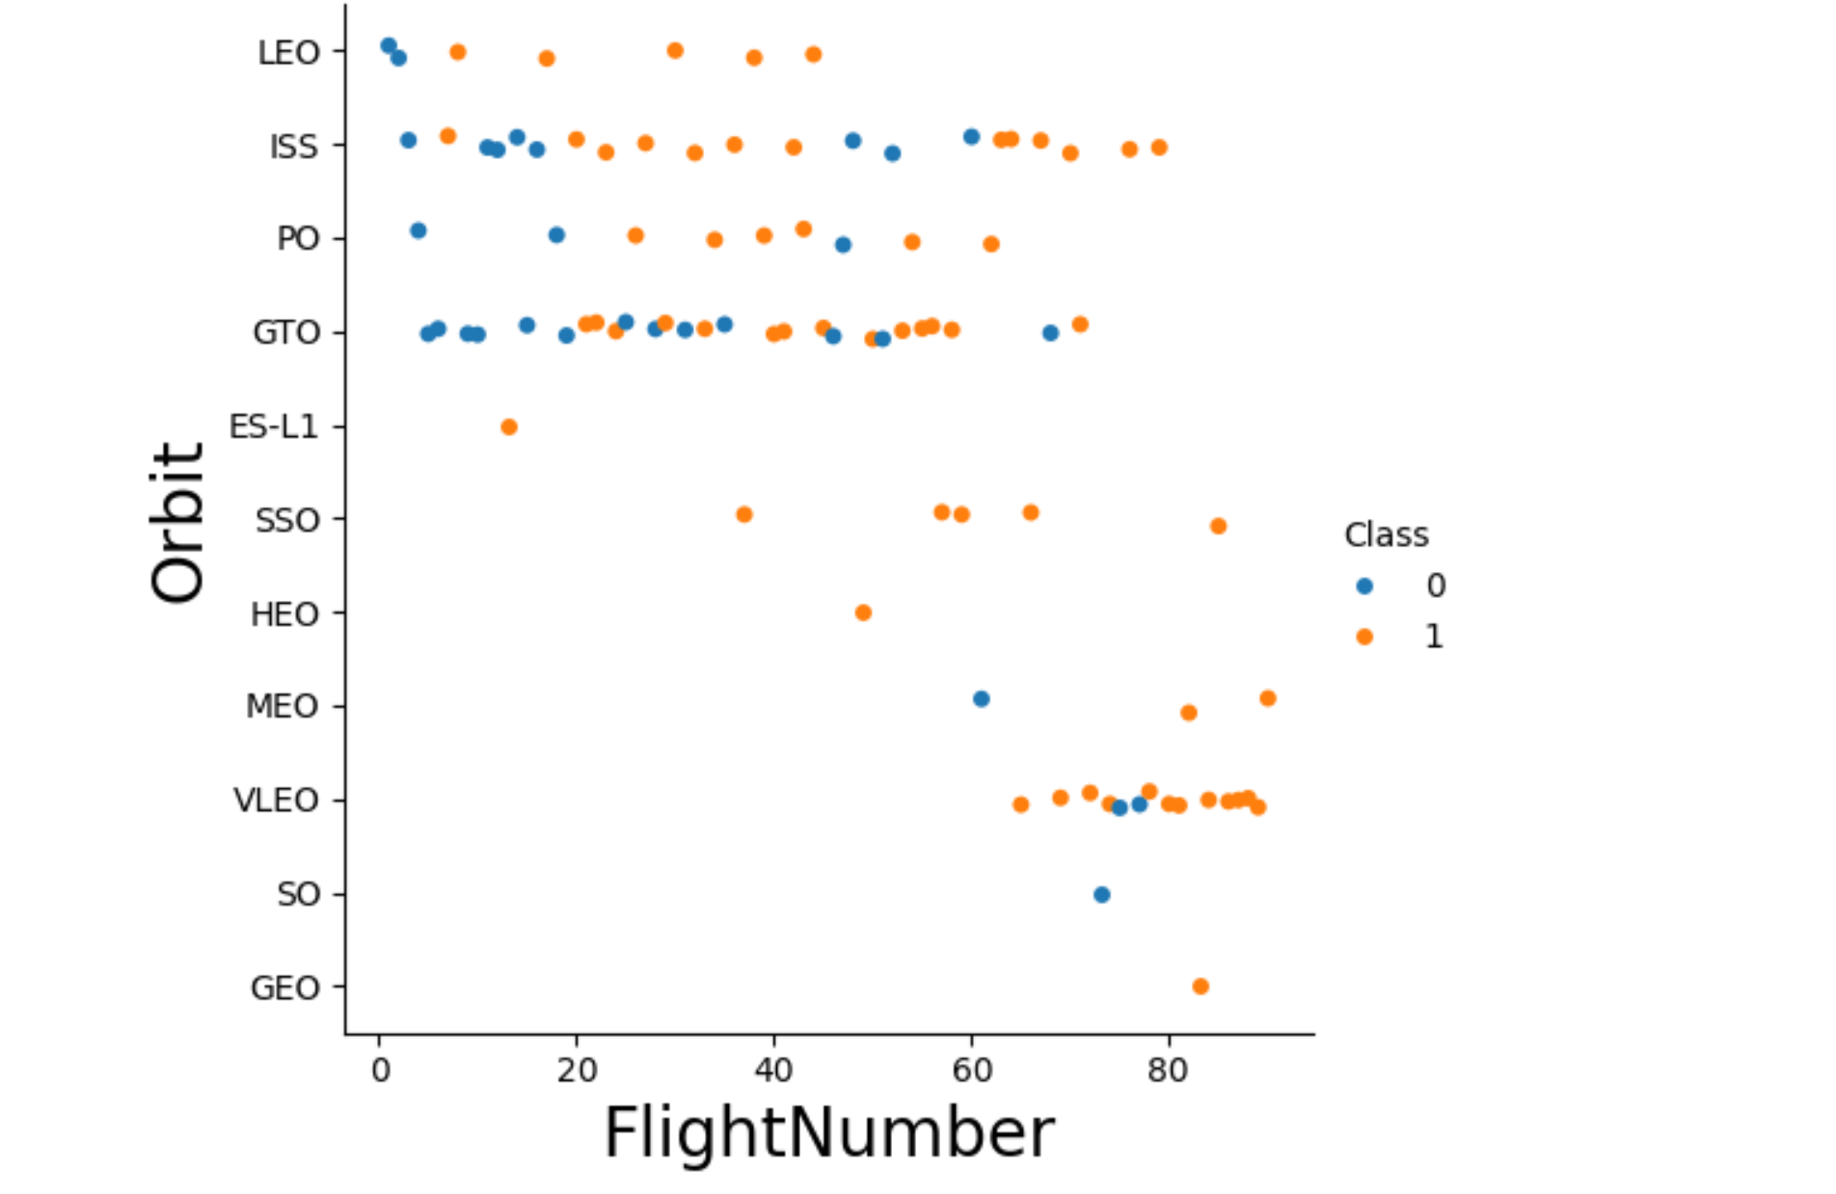
Flight Number vs. Orbit Type
In the LEO orbit the landing tends to be successful with increasing the number of flight. Likewise VLEO while SSO always shows positive landing. Finally there seems to be no relationship between flight number and success rate in GTO orbit.

Slide 22
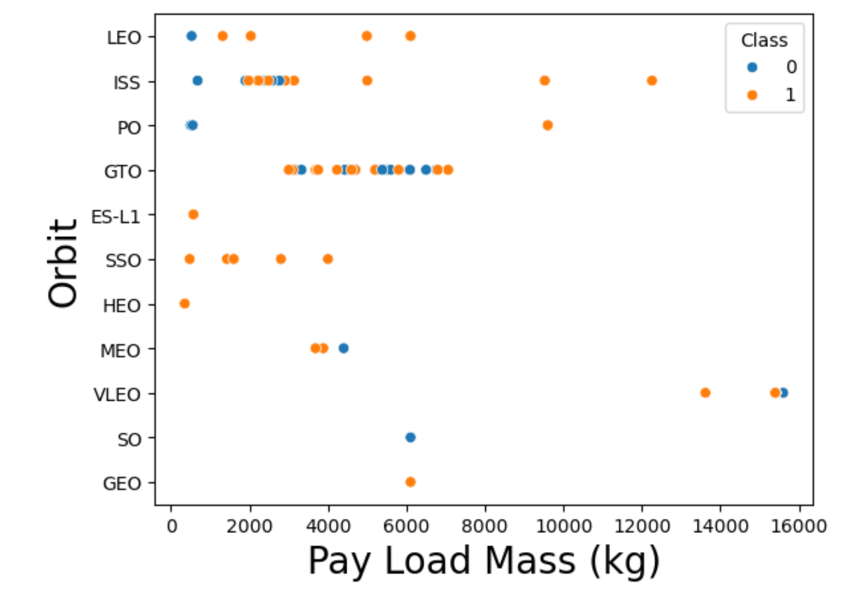
Payload vs. Orbit Type
GTO suPolar, LEO and ISS show to have succesful landing with big payloads
Success rate does not seem to be influenced by Pay Load Massive. SSO is always positive regardless of the Mass while for the others, we have too few records to identify a real trend.

Slide 23
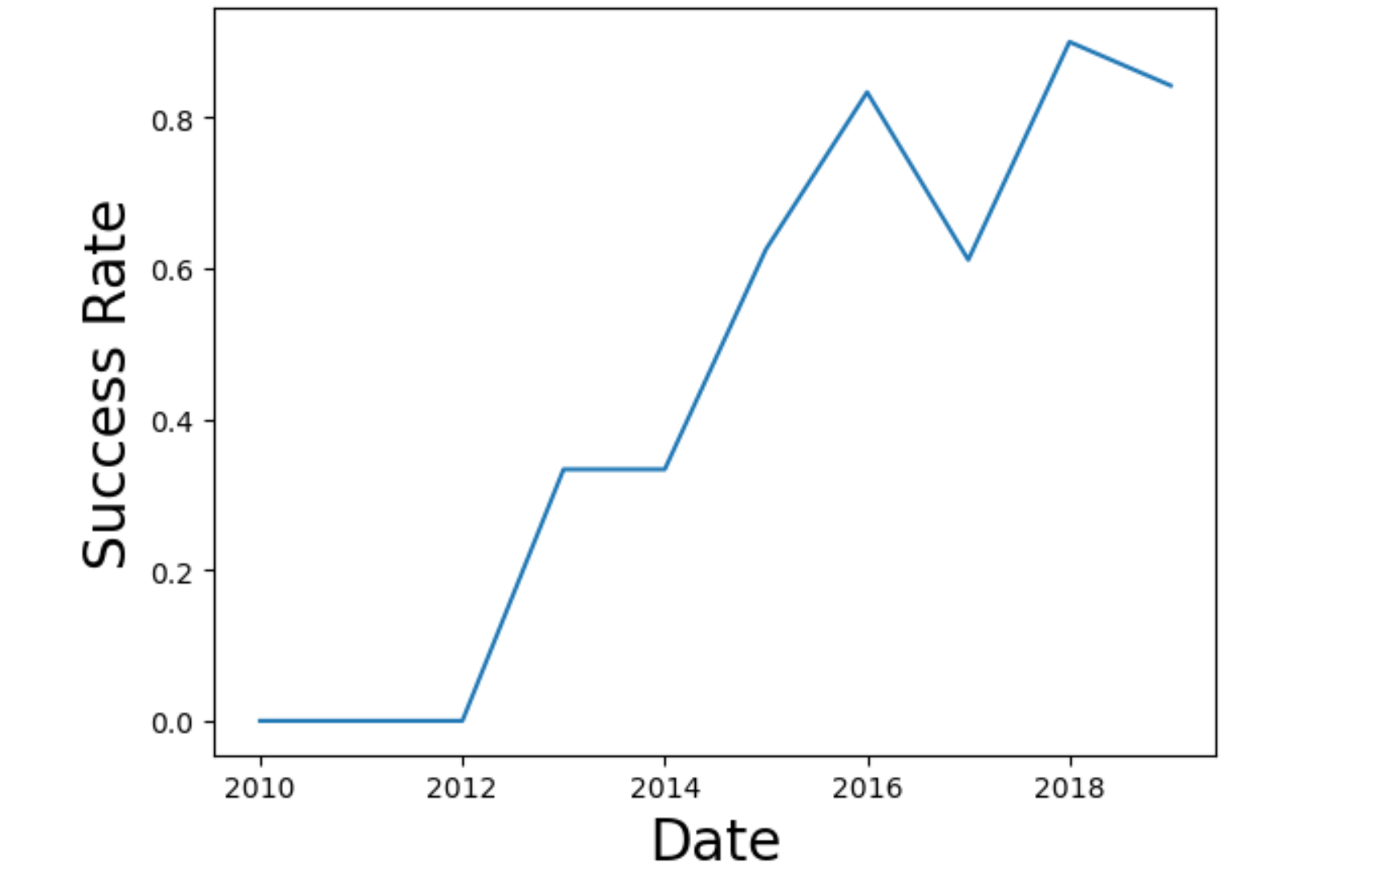
Launch Success Yearly Trend
As of 2013 it is noticed that the success rate kept increasing.

Slide 24
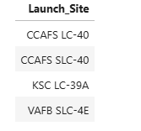
All Launch Site Names
Query
Result
Explanation
The query retrieves the names of the unique launch sites in the space mission thanks the use of DISTINCT which select unique values.

Slide 25
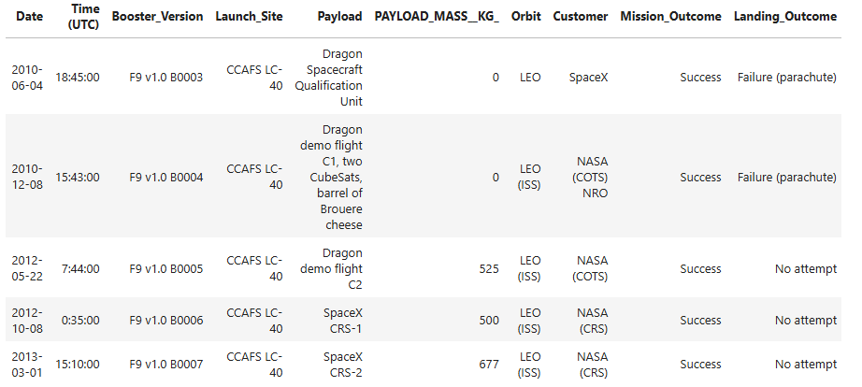
Launch Site Names Begin with 'CCA'
Query
Explanation
The query displays 5 records where launch sites begin with the string 'CCA’; LIMIT makes that only 5 sites are shown; the LIKE “CCA%” select all names beginning with “CCA”
Result

Slide 26
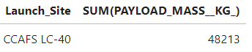
Total Payload Mass
Query
Result
Explanation
Displays total payload mass carried by boosters launched by NASA (CRS) by applying the SUM to calculate the total value and LIKE to limit the choice to NASA (CRS)

Slide 27

Average Payload Mass by F9 v1.1
Query
Result
Explanation
Display average payload mass carried by booster version F9 v1.1 with the use of AVG to calculate the average value and LIKE “F9 v1.1”to specify the booster version
27

Slide 28
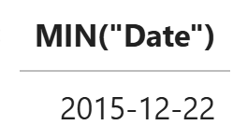
First Successful Ground Landing Date
Query
Result
Explanation
List the date when the first successful landing outcome in ground pad was achieved using MIN to find the earliest date and WHERE clause to specify that the landing outcome is in ground pad

Slide 29
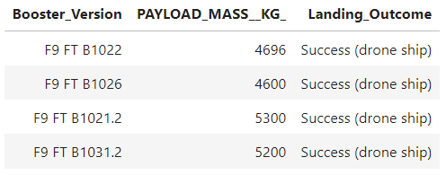
Successful Drone Ship Landing with Payload between 4000 and 6000
Query
Result
Explanation
List the names of the boosters which have success in drone ship and have payload mass greater than 4000 but less than 6000 thanks to where clause that limit Landing outcome to ‘Success(drone ship)’and Payload Mass in the mentioned interval

Slide 30
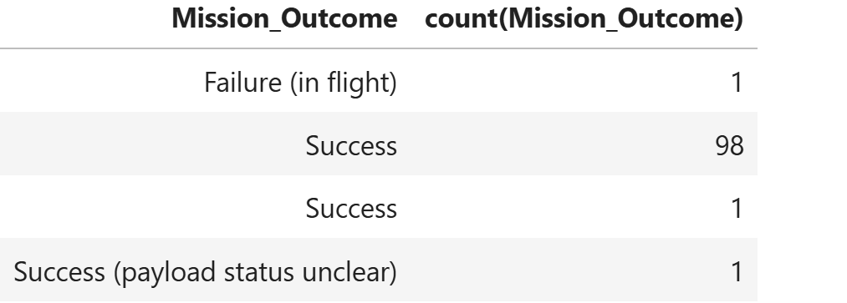
Total Number of Successful and Failure Mission Outcomes
Query
Result
Explanation
List the total number of successful and failure mission outcomes using
the COUNT to pick the total number of mission outcomes and GROUP BY clause to have the results differentiated by the mission outcomes

Slide 31
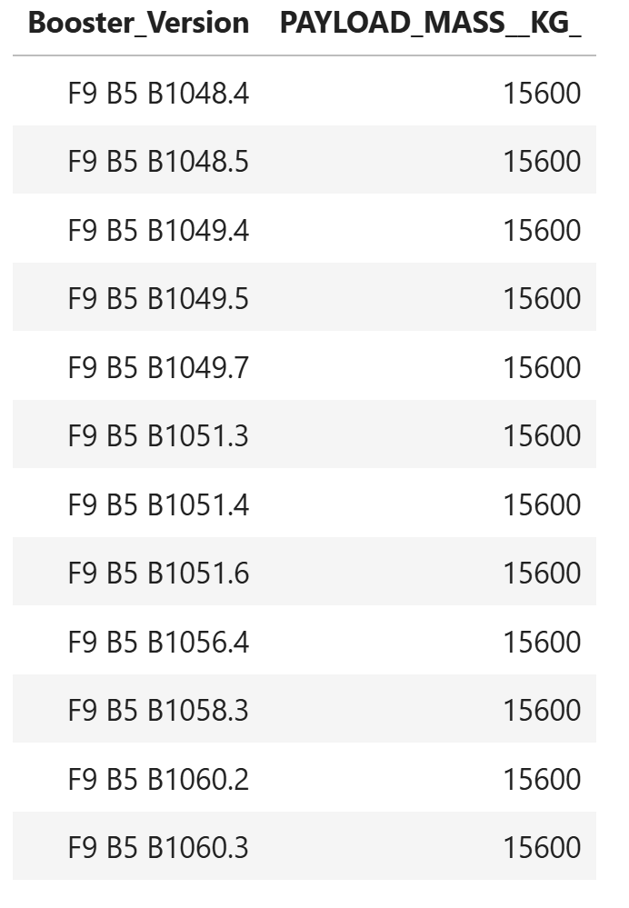
Boosters Carried Maximum Payload
Query
Explanation
List the names of the booster versions which have carried the maximum payload mass by using a subquery clause in the where clause to limit the choice to the maximum payload mass
Result

Slide 32
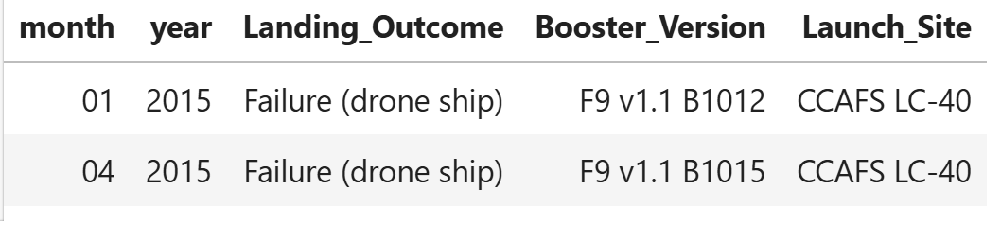
2015 Launch Records
Query
Result
Explanation
The query returns the 2015 Launch Records by using in the where clause the date substring and limiting the results to the failure landing outcomes in drone ship.

Slide 33
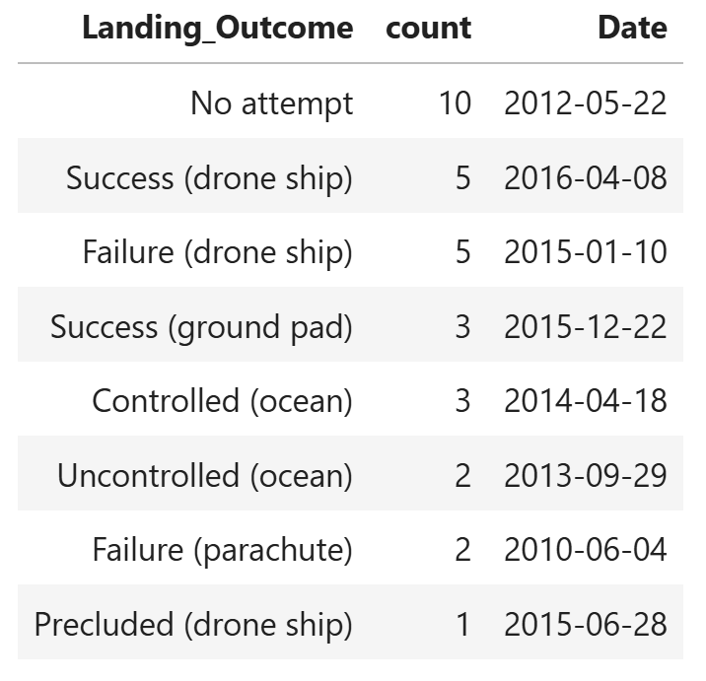
Rank Landing Outcomes Between 2010-06-04 and 2017-03-20
Query
Result
Explanation
The query Ranks the count of landing between the date 2010-06-04 and 2017-03-20, in descending order by using the count and grouping the result by the Landing Outcome within the desired time frame.

Slide 34

Section 3

Slide 35
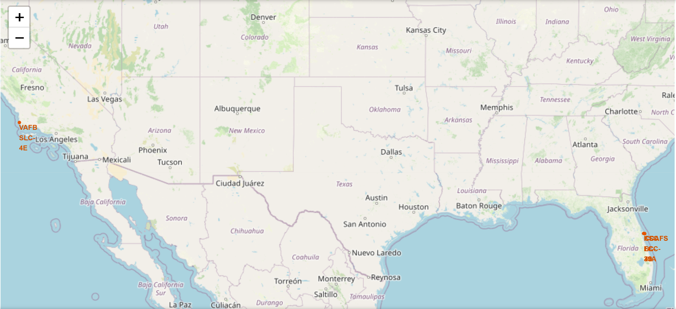
Folium Map of United States with all the Launch Sites marked
Findings: All launch sites are not close to the Equator line and they are all in very close proximity to the coast to reduce the payload costs involved in first stage landing on land.

Slide 36
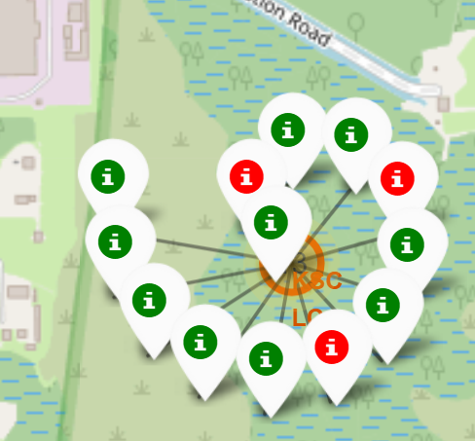
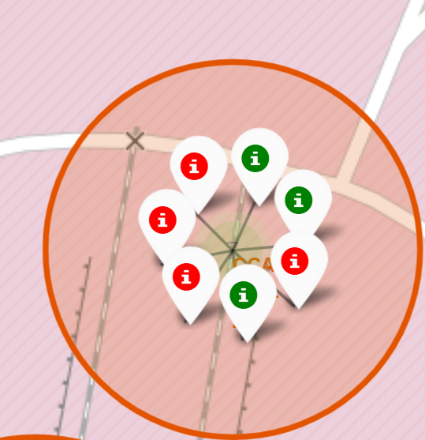
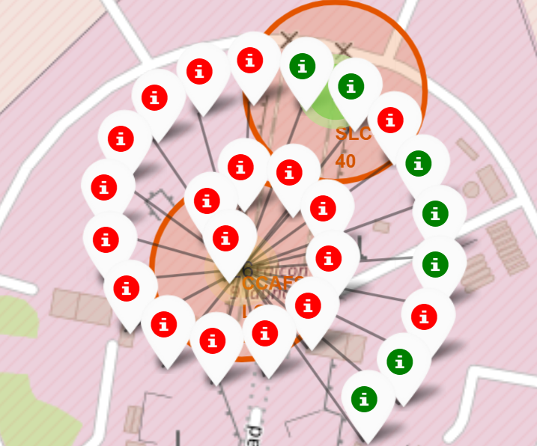
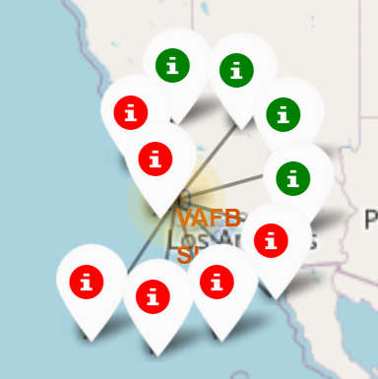
Mark Success/Failed Launches For Each Site
KSC LC-39A
CCAFS SLC-40
CCAFS LC-40
VAFB SLC-4E
Findings: KSC LC-39A has the highest success rate; the others have relatively low success rate.

Slide 37
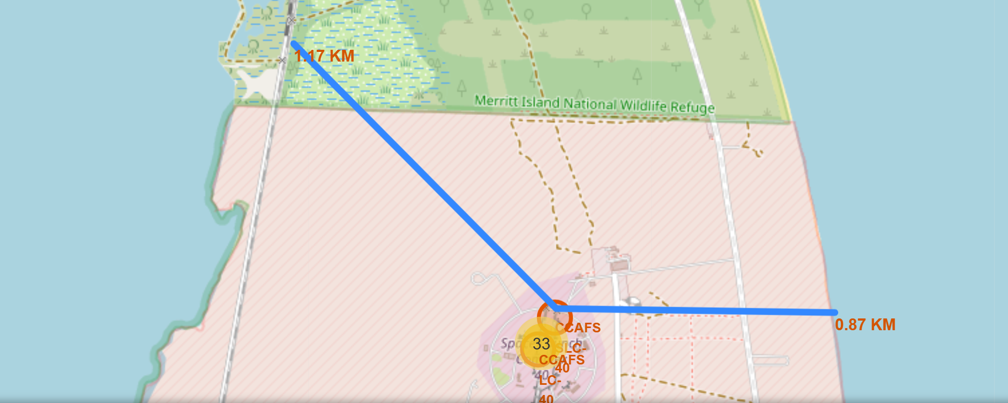
Distances Between Launch Sites to Its Proximities
Findings: Launch sites are in close proximity to the coastline but not to railways nor highways. Additionally they keep certain distance away from cities.

Slide 38

Section 4

Slide 39
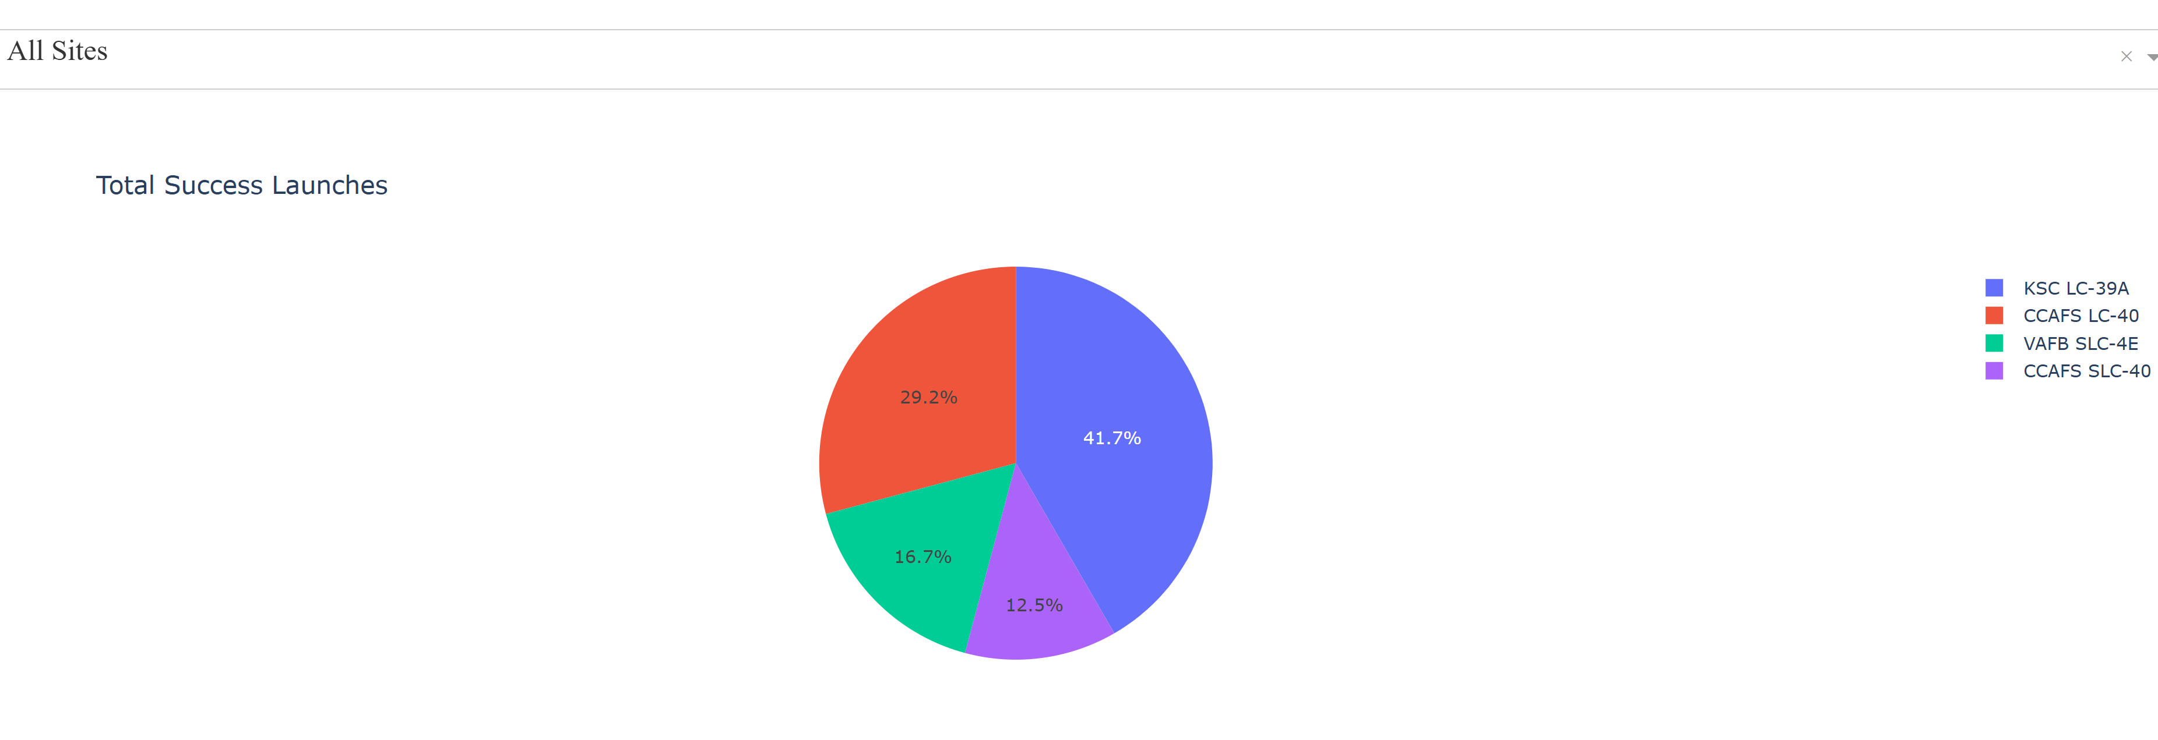
Total Success Launches For All Sites
Findings: KSC LC-39A has both the highest launch success rate (41,7%) and the largest successful launches (10)

Slide 40
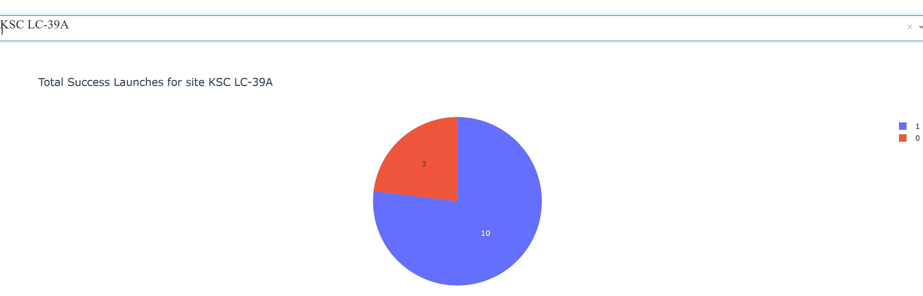
Launch Site with highest launch success ratio
Findings: KSC LC-39A had 10 successful launches ratio out of 13

Slide 41
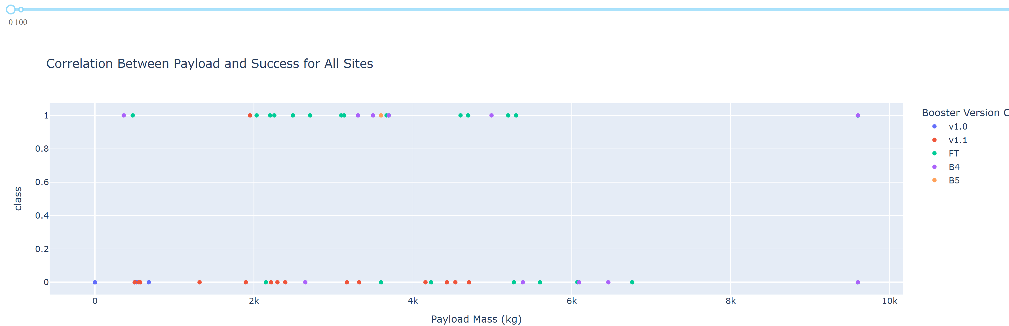
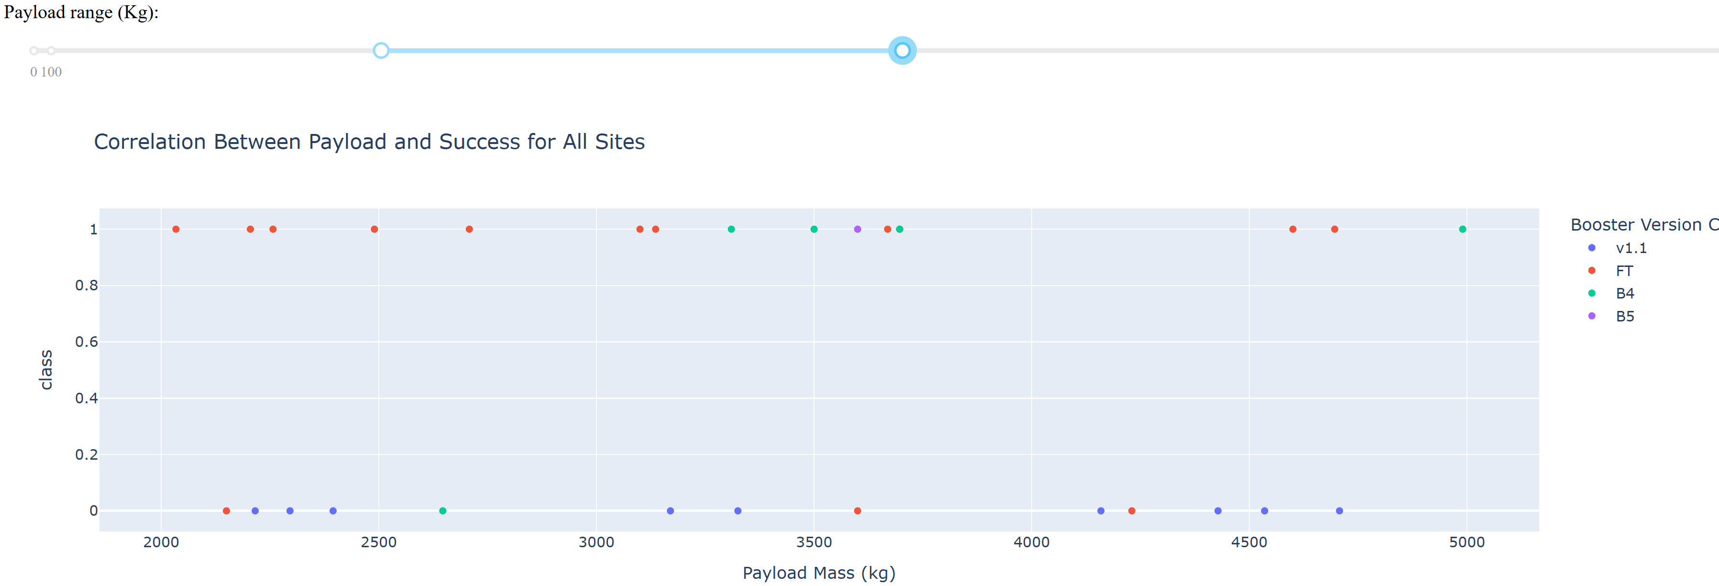
Correlation Between Payload Mass and Success 1
Findings: FT and B5 booster version have the highest launch success rate even though there is only one B5 launch ever
Findings: The range with the highest launch success rate is the 2000 -:- 3800 kg of Payload Mass

Slide 42
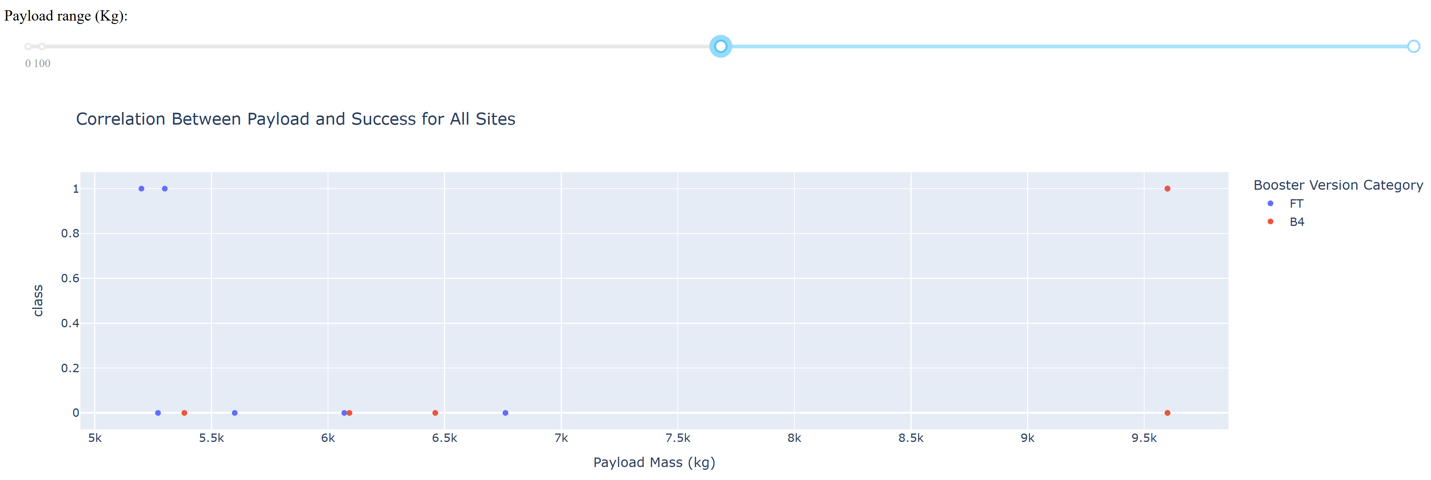
Correlation Between Payload Mass and Success 2
Findings: The range with the lowest launch success rate is any Payload Mass greater than 5.500 kg

Slide 43

Section 5

Slide 44
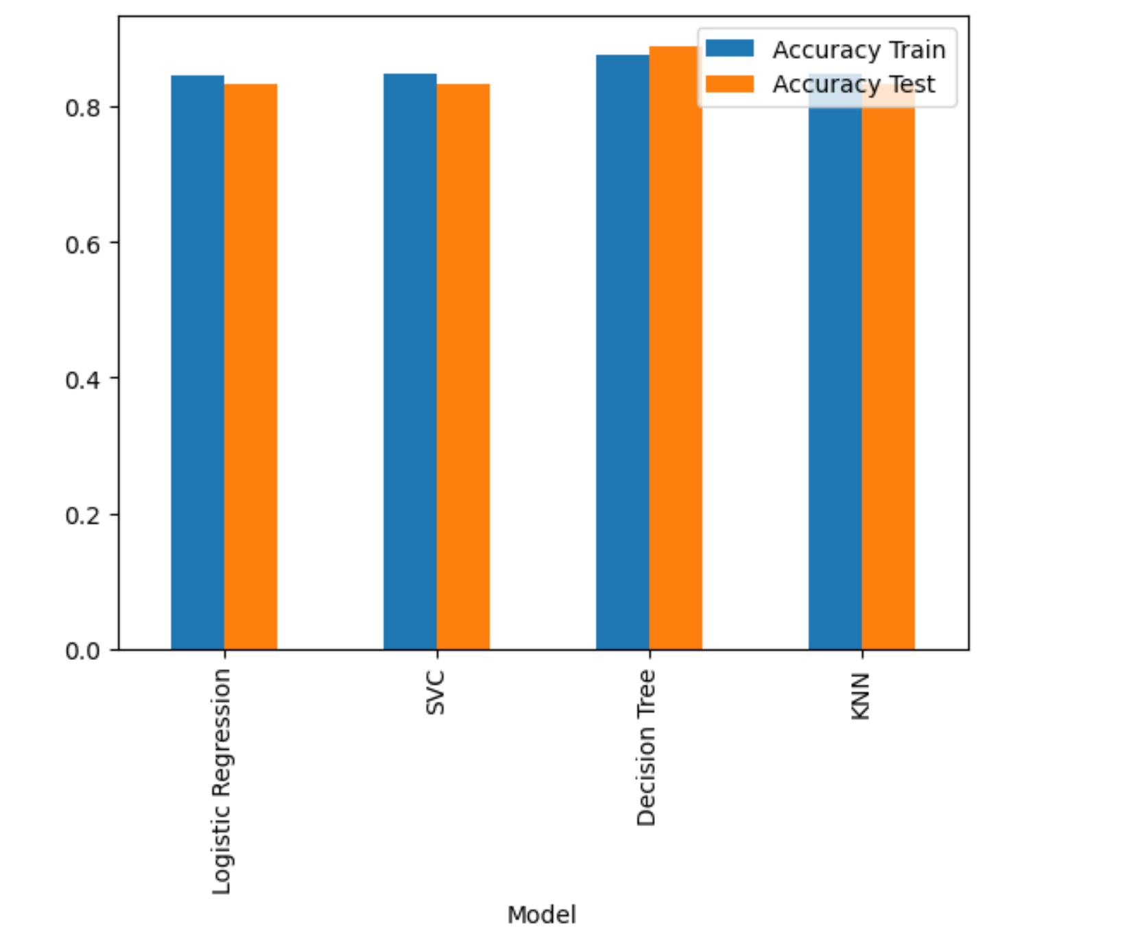
Classification Accuracy
The bar chart shows that the decision tree is the best model because it has the highest training and test accuracy scores

Slide 45
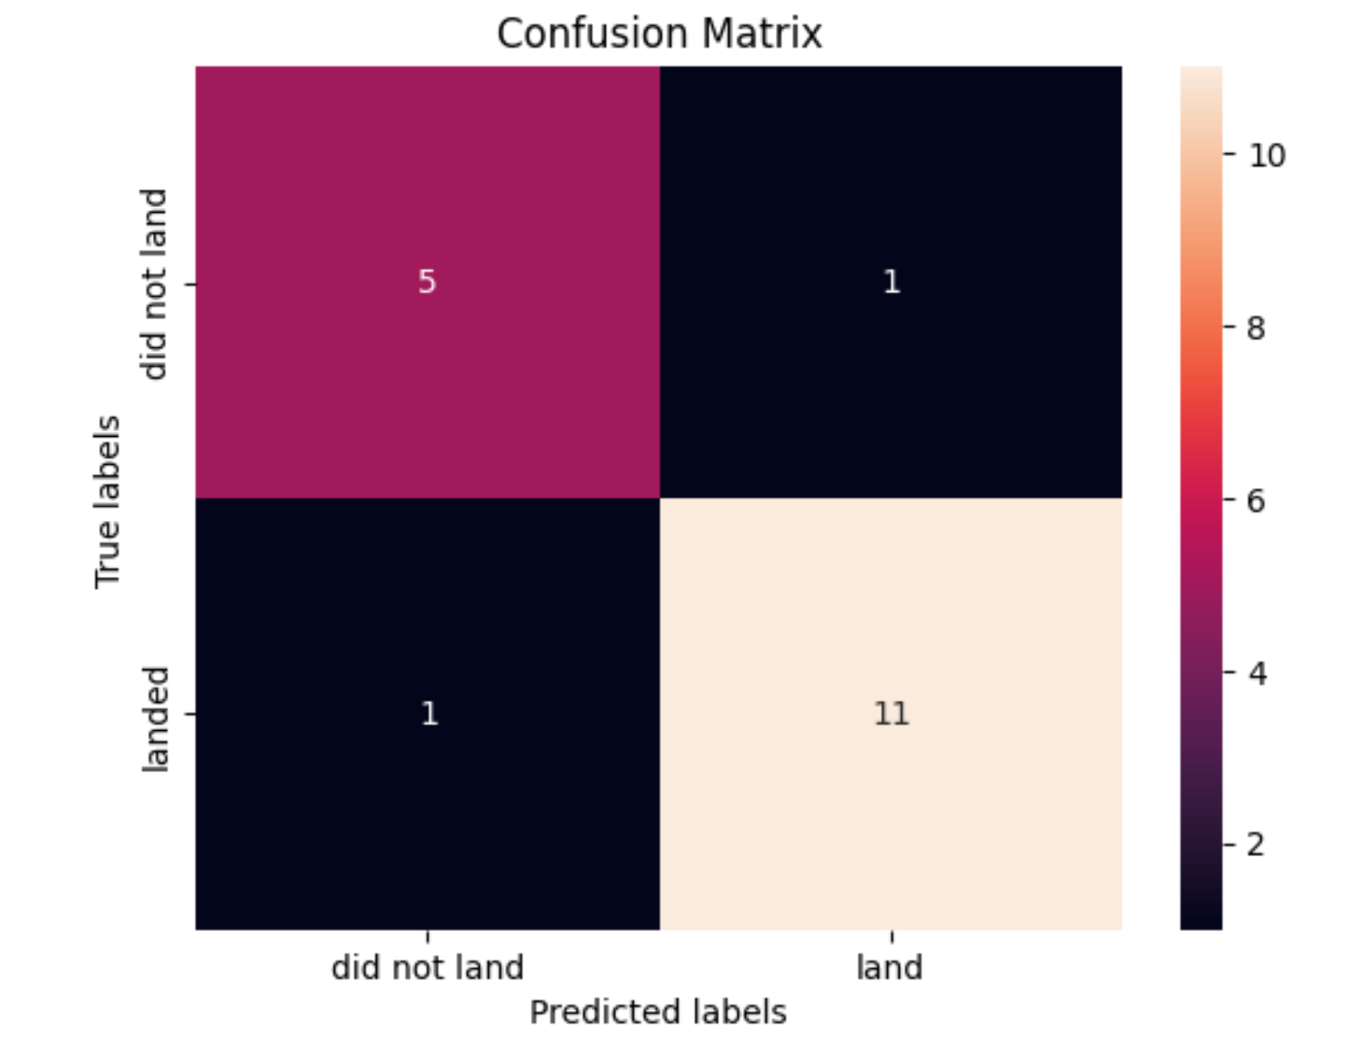
Confusion Matrix
For the Decision Tree Model, out of 18 predictions, we had 1 False Positive, 1 False Negative, 11 True Positive and 5 True Negative.
The recall rate is quite high (recall=TP/(TP+FN)=11/12 = 0.916)

Slide 46
Conclusions
SpaceX has steadily improved its launch success rate over the years.
Launches to destinations like Earth-Sun L1, Geostationary Earth Orbit (GEO), High Earth Orbit (HEO), and Sun-Synchronous Orbit (SSO) tend to have the highest success rates.
In general the most successful launches occur when the payload mass falls within the range of 2000 to 3800 kg. but launches to GTO, Sun-Polar, LEO, and ISS have a high success rate for landing even with substantial payloads
Among SpaceX launch sites, KSC LC-39A boasts the most successful launches
All launch sites are not close to the Equator line and they are all in very close proximity to the coast to reduce the payload costs involved in first stage landing on land
Among the models tested, the tree classifier demonstrated the highest predictive accuracy for launch success.

Slide 47
Appendix
A full list of datasets, with links to the respective notebooks used for this SpaceX project is available at this link:
https://github.com/bejaflor66/applied-data-science-capstone

Slide 48


